Slide 1
Logistic Regression

Slide 2
Agenda
What is Logistic Regression?
* Why Logistic Regression?
* When to apply Logistic Regression?
* Logistic Regression vs Linear Regression vs LDA
* Assumptions of Logistic Regression
* Limitations of Logistic Regression
* Model Validation and Accuracy Metrics

Slide 3
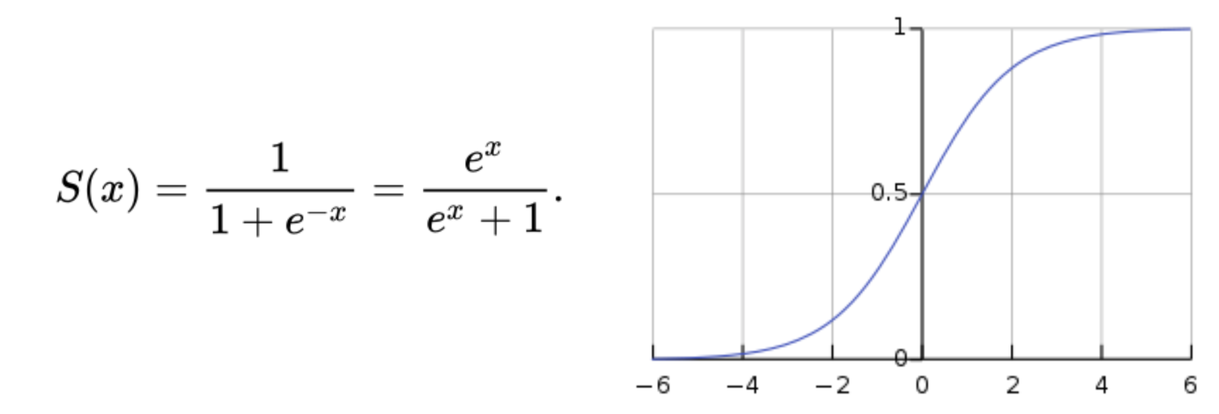
What is Logistic Regression?
Logistic Regression is a Machine Learning classification algorithm that is used to predict the probability of a categorical dependent variable. In logistic regression, the dependent variable is a binary variable that contains data coded as 1 (yes, success, etc.) or 0 (no, failure, etc.). In other words, the logistic regression model predicts P(Y=1) as a function of X.

Slide 4
Why Logistic Regression?
Advantages of Logistic Regression
1. Logistic Regression performs well when the dataset is linearly separable.
2. Logistic regression is less prone to over-fitting but it can overfit in high dimensional datasets. You should consider Regularization (L1 and L2) techniques to avoid over-fitting in these scenarios.
3. Logistic Regression not only gives a measure of how relevant a predictor (coefficient size) is, but also its direction of association (positive or negative).
4. Logistic regression is easier to implement, interpret and very efficient to train.

Slide 5
When to apply Logistic Regression?
Logistic Regression is used when the dependent variable (target) is categorical. For example, To predict whether an email is spam (1) or (0) Whether the tumor is malignant (1) or not (0)
We can’t use linear regression on a categorical dependent variable. Because we won’t be appreciated for getting extremely low values of adjusted R² and F statistic.

Slide 6
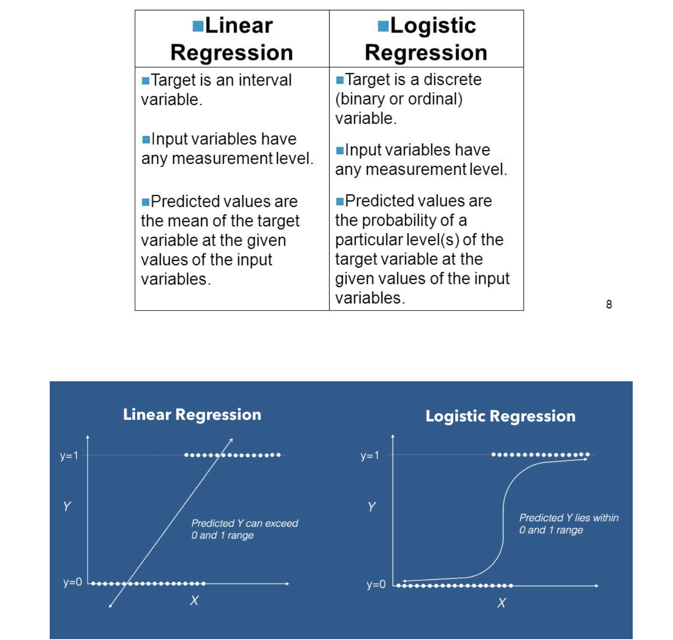

Slide 7
LDA vs LR
Discriminant analysis creates discriminant function(s) in order to maximize the difference between the groups on the function. Logistic regression works like ordinary least squares regression but on the logit of the dependent variable.
Discriminant analysis is really used only for categorization. Logistic regression is often used when we aren’t even interested in categorization but in getting the odds ratios for each variable.

Slide 8
LDA vs LR
LDA is a more appropriate method when the explanatory variables are normally distributed. In the case of categorised variables, LDA remains preferable and fails only when the number of categories is really small (2 or 3). The results of LR, however, are in all these cases constantly close and a little worse than those of LDA. But whenever the assumptions of LDA are not met, the usage of LDA is not justified, while LR gives good results regardless of the distribution. As the estimates for LR are obtained by the maximum likelihood method, they have a number of nice asymptotic properties as well.

Slide 9
Binary Logistic regression | Linear Discriminant analysis also known as Fisher's LDA
Based on Maximum likelihood estimation | Based on Least squares estimation; equivalent to linear regression with binary predictand (coefficients are proportional and R-square = 1-Wilk's lambda).
Estimates probability (of group membership) immediately (the predictand is itself taken as probability, observed one) and conditionally. | estimates probability mediately (the predictand is viewed as binned continuous variable, the discriminant) via classificatory device (such as naive Bayes) which uses both conditional and marginal information.
Not so sensitive to outliers | Quite sensitive to outliers.
No requirements about the within-group covariance matrices of the predictors | The within-group covariance matrices should be identical in population.

Slide 10
Binary logistic regression major assumptions:
The dependent variable should be dichotomous in nature (e.g., presence vs. absent).
There should be no outliers in the data, which can be assessed by converting the continuous predictors to standardized scores, and removing values below -3.29 or greater than 3.29.
There should be no high correlations (multicollinearity) among the predictors. This can be assessed by a correlation matrix among the predictors. Tabachnick and Fidell (2013) suggest that as long correlation coefficients among independent variables are less than 0.90 the assumption is met.

Slide 11
Binary logistic regression major assumptions:
Binary logistic regression requires the dependent variable to be binary.
The independent variables are linearly related to the log odds.
Logistic regression requires quite large sample sizes.

Slide 12
Disadvantages of Logistic Regression
1. Main limitation of Logistic Regression is the assumption of linearity between the dependent variable and the independent variables. In the real world, the data is rarely linearly separable. Most of the time data would be a jumbled mess.
2. If the number of observations are lesser than the number of features, Logistic Regression should not be used, otherwise it may lead to overfit.
3. Logistic Regression can only be used to predict discrete functions. Therefore, the dependent variable of Logistic Regression is restricted to the discrete number set. This restriction itself is problematic, as it is prohibitive to the prediction of continuous data.

Slide 13
Model Validation and Accuracy Metrics
Overfitting. When selecting the model for the logistic regression analysis, another important consideration is the model fit. Adding independent variables to a logistic regression model will always increase the amount of variance explained in the log odds (typically expressed as R²). However, adding more and more variables to the model can result in overfitting, which reduces the generalizability of the model beyond the data on which the model is fit.
Reporting the R2. Numerous pseudo-R2 values have been developed for binary logistic regression. These should be interpreted with extreme caution as they have many computational issues which cause them to be artificially high or low. A better approach is to present any of the goodness of fit tests available; Hosmer-Lemeshow is a commonly used measure of goodness of fit based on the Chi-square test.

Slide 14
Model Evaluation
Area Under ROC Curve.
Confusion Matrix.
precision/recall
F score
Others

Slide 15
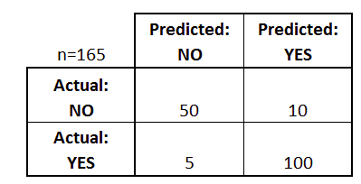
Confusion Matrix
ROC Curve and AUC
The ROC is a curve generated by plotting the true positive rate (TPR) against the false positive rate (FPR) at various threshold settings while the AUC is the area under the ROC curve. As a rule of thumb, a model with good predictive ability should have an AUC closer to 1 (1 is ideal) than to 0.5.
Confusion Matrix helps determine classifier

Slide 16
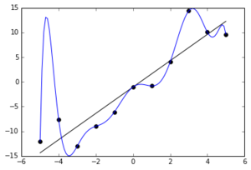
Odds Ratio and Overfitting
Odds ratio = p/1-p where p is probability of success
Logit = log (odds ratio)
Overfitting -It occurs when the model is closer to sample data than real data and it occurs due to excessive noise. It is avoided by splitting the data into test and training, and then building the model on one part of data

Slide 17
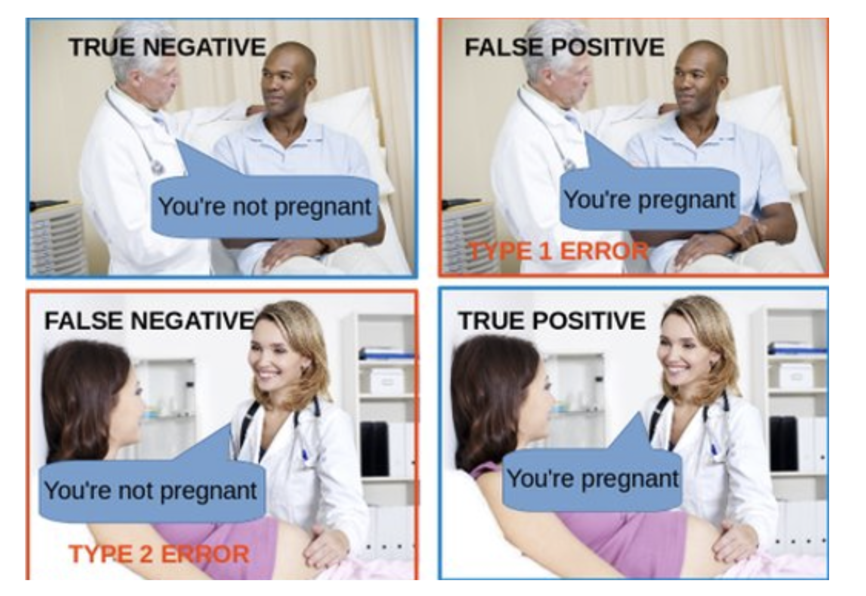
Errors

Slide 18
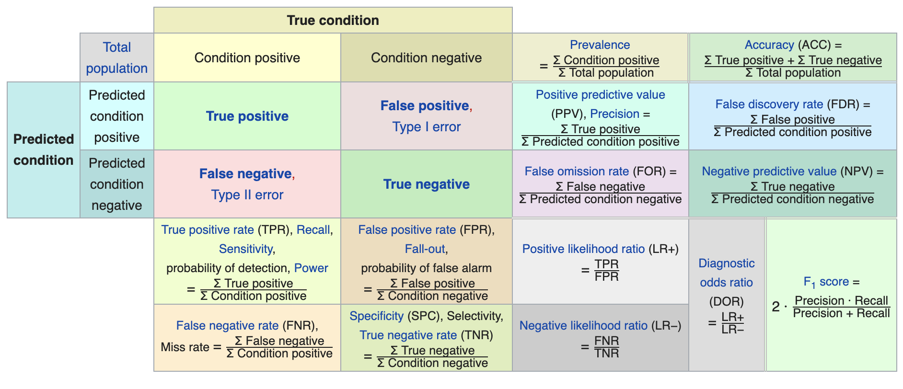

Slide 21
Packages for Logistic Regression
EDA- seaborn
Logit- scikit-learn, statsmodel

Slide 22
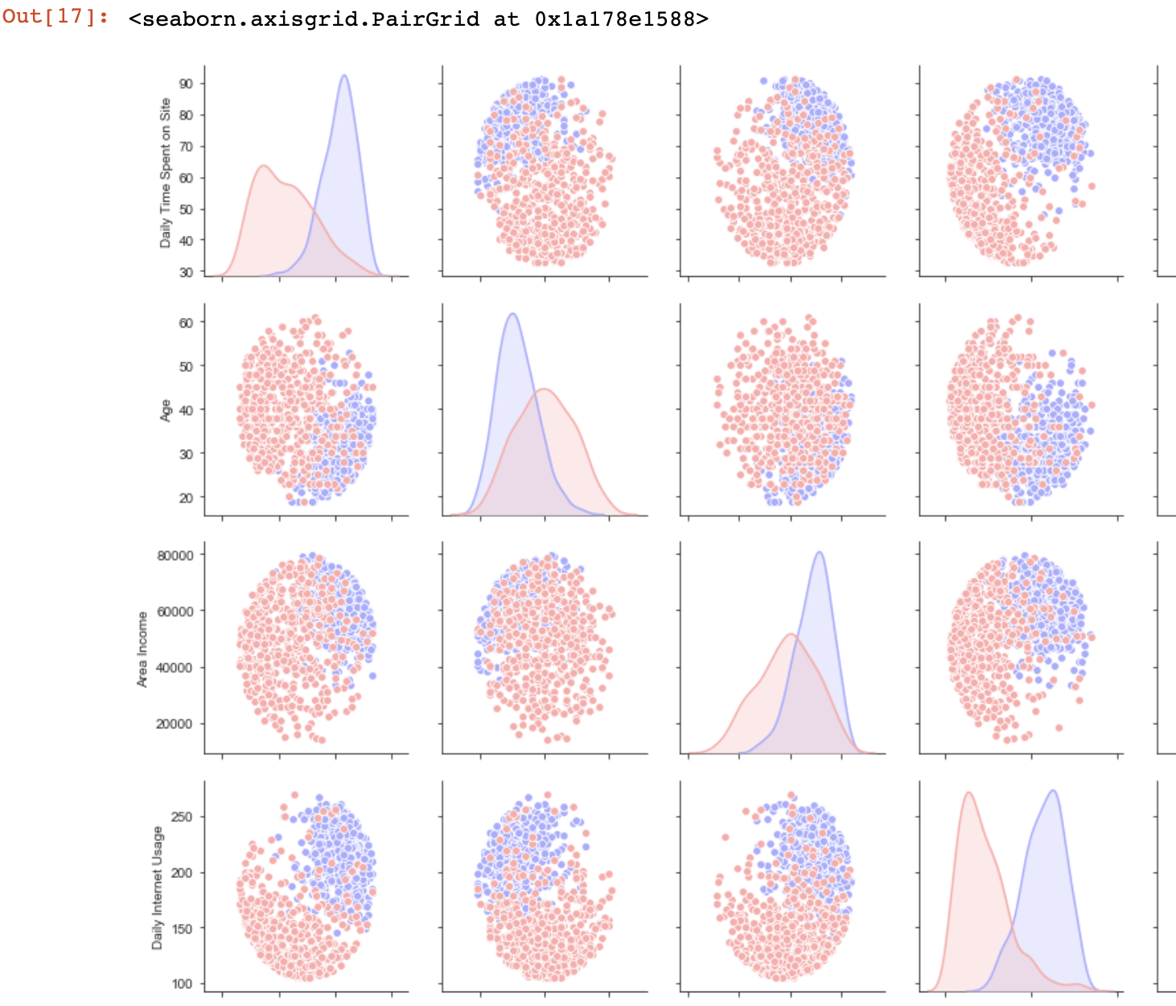
EDA

Slide 23
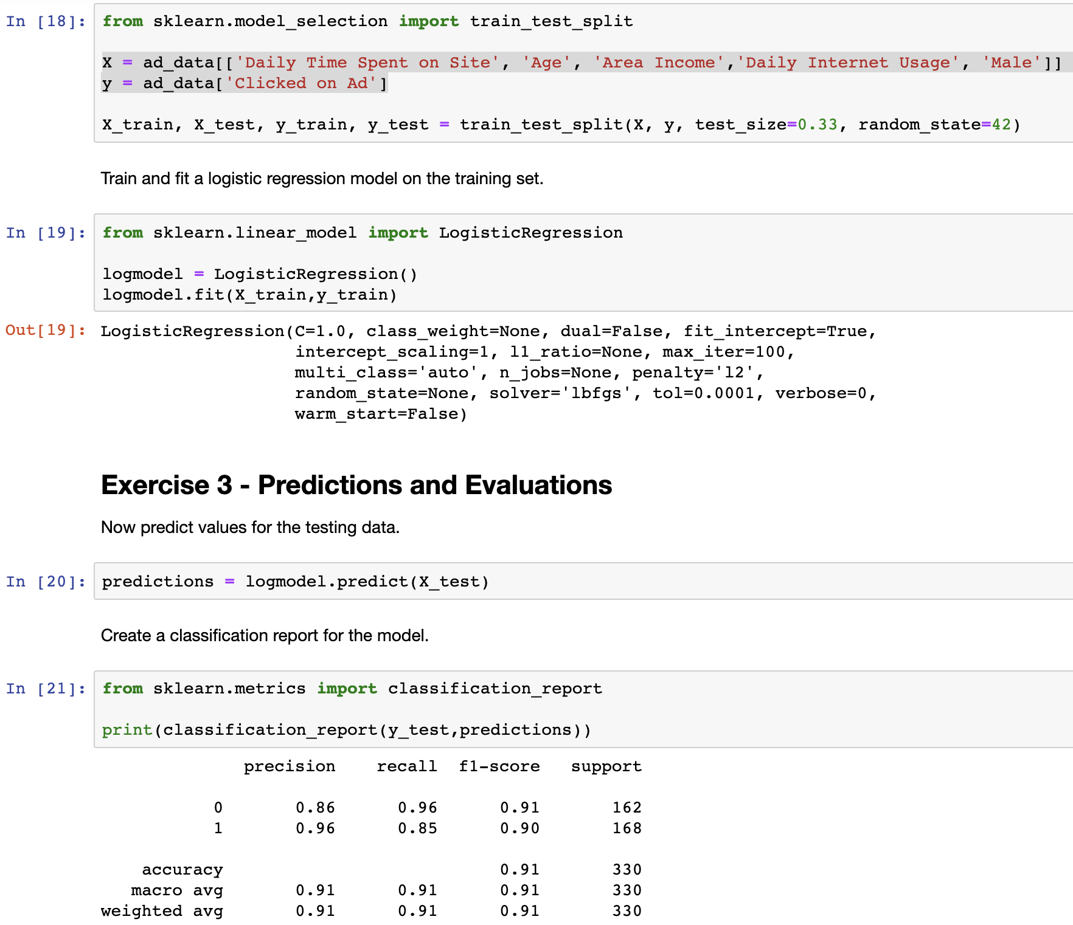
Model

Slide 24
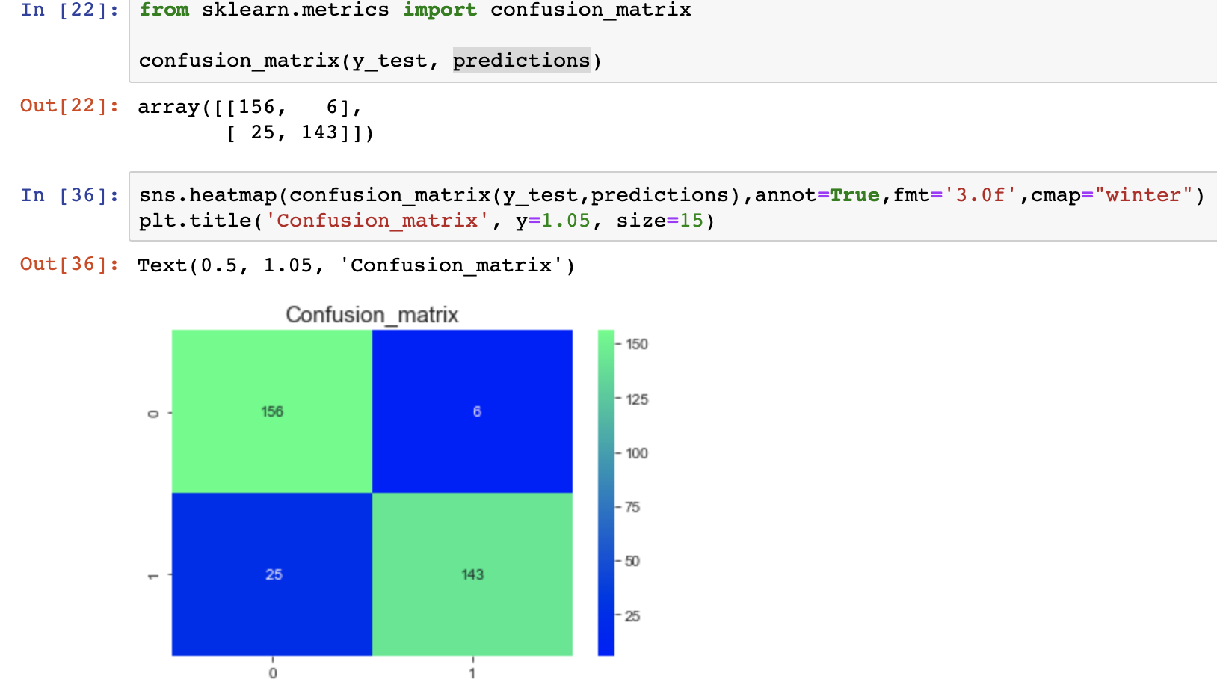
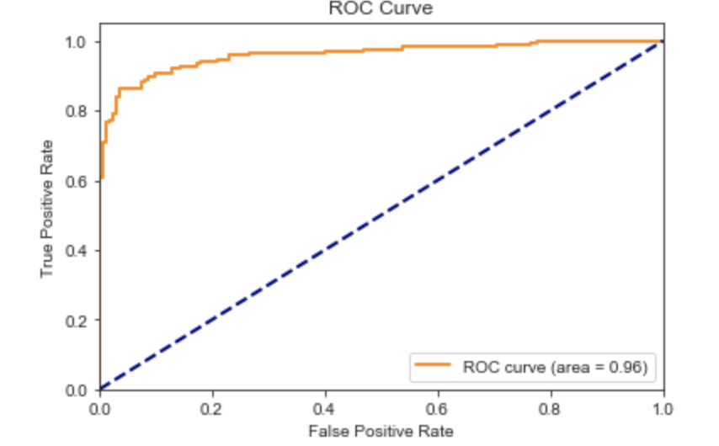
Results

Slide 25
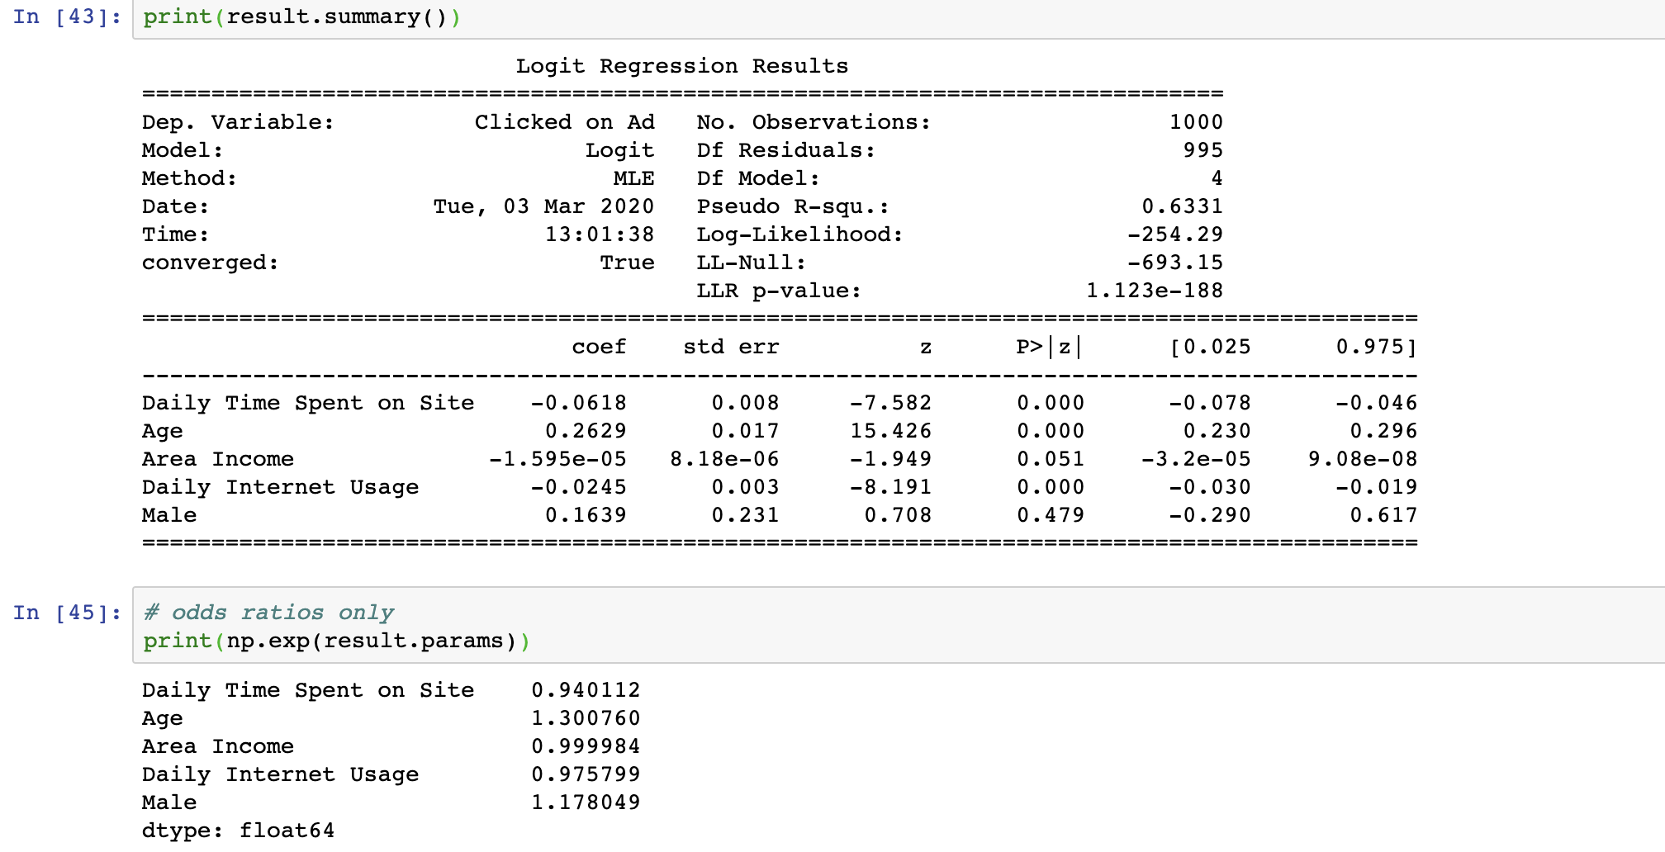
Statsmodel

